Slide 1

Control Systems (CS)
Lecture-14-15
Time Domain Analysis of 2nd Order Systems

Slide 2
Introduction
We have already discussed the affect of location of poles and zeros on the transient response of 1st order systems.
Compared to the simplicity of a first-order system, a second-order system exhibits a wide range of responses that must be analyzed and described.
Varying a first-order system's parameter (T, K) simply changes the speed and offset of the response
Whereas, changes in the parameters of a second-order system can change the form of the response.
A second-order system can display characteristics much like a first-order system or, depending on component values, display damped or pure oscillations for its transient response.

Slide 3
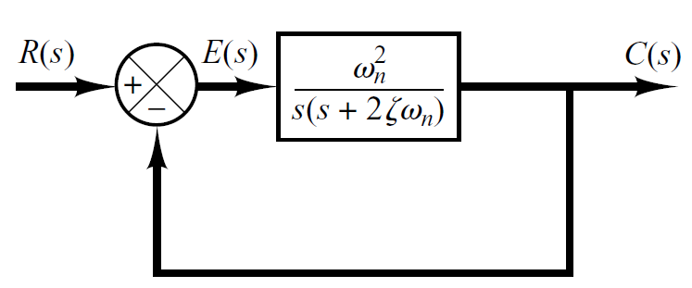
Introduction
A general second-order system is characterized by the following transfer function.
un-damped natural frequency of the second order system, which is the frequency of oscillation of the system without damping.
damping ratio of the second order system, which is a measure of the degree of resistance to change in the system output.

Slide 4
Example#1
Determine the un-damped natural frequency and damping ratio of the following second order system.
Compare the numerator and denominator of the given transfer function with the general 2nd order transfer function.

Slide 5
Introduction
Two poles of the system are

Slide 6
Introduction
According the value of , a second-order system can be set into one of the four categories:
Overdamped - when the system has two real distinct poles ( >1).
jω
δ
-c
-b
-a

Slide 7
Introduction
According the value of , a second-order system can be set into one of the four categories:
2. Underdamped - when the system has two complex conjugate poles (0 < <1)
jω
δ
-c
-b
-a

Slide 8
Introduction
According the value of , a second-order system can be set into one of the four categories:
3. Undamped - when the system has two imaginary poles ( = 0).
jω
δ
-c
-b
-a

Slide 9
Introduction
According the value of , a second-order system can be set into one of the four categories:
4. Critically damped - when the system has two real but equal poles ( = 1).
jω
δ
-c
-b
-a

Slide 10
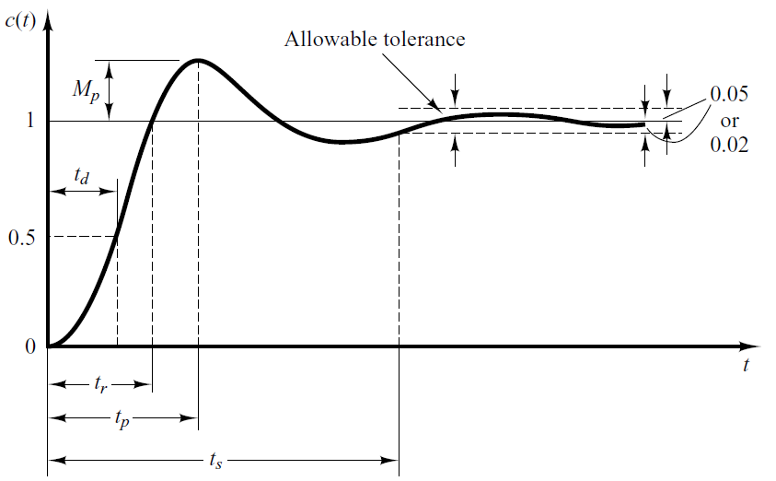
Time-Domain Specification
For 0< <1 and ω_{n} > 0, the 2nd order system’s response due to a unit step input looks like

Slide 11
Time-Domain Specification
The delay (t_{d}) time is the time required for the response to reach half the final value the very first time.

Slide 12
Time-Domain Specification
The rise time is the time required for the response to rise from 10% to 90%, 5% to 95%, or 0% to 100% of its final value.
For underdamped second order systems, the 0% to 100% rise time is normally used. For overdamped systems, the 10% to 90% rise time is commonly used.
12

Slide 13
Time-Domain Specification
The peak time is the time required for the response to reach the first peak of the overshoot.
13
13

Slide 14

Time-Domain Specification
The maximum overshoot is the maximum peak value of the response curve measured from unity. If the final steady-state value of the response differs from unity, then it is common to use the maximum percent overshoot. It is defined by
The amount of the maximum (percent) overshoot directly indicates the relative stability of the system.

Slide 15
Time-Domain Specification
The settling time is the time required for the response curve to reach and stay within a range about the final value of size specified by absolute percentage of the final value (usually 2% or 5%).

Slide 16
S-Plane
Natural Undamped Frequency.
jω
Distance from the origin of s-plane to pole is natural undamped frequency in rad/sec.
δ

Slide 17
S-Plane
Let us draw a circle of radius 3 in s-plane.
If a pole is located anywhere on the circumference of the circle the natural undamped frequency would be 3 rad/sec.
jω
3
-3
3
δ
-3

Slide 18
S-Plane
Therefore the s-plane is divided into Constant Natural Undamped Frequency (ω_{n}) Circles.
jω
δ

Slide 19
S-Plane
Damping ratio.
Cosine of the angle between vector connecting origin and pole and –ve real axis yields damping ratio.
jω
δ

Slide 20
S-Plane
For Underdamped system therefore,
jω
δ

Slide 21
S-Plane
For Undamped system therefore,
jω
δ

Slide 22
S-Plane
For overdamped and critically damped systems therefore,
jω
δ

Slide 23
S-Plane
Draw a vector connecting origin of s-plane and some point P.
jω
P
δ

Slide 24
S-Plane
Therefore, s-plane is divided into sections of constant damping ratio lines.
jω
δ

Slide 25
Example-2
Determine the natural frequency and damping ratio of the poles from the following pz-map.

Slide 26
Example-3
Determine the natural frequency and damping ratio of the poles from the given pz-map.
Also determine the transfer function of the system and state whether system is underdamped, overdamped, undamped or critically damped.

Slide 27
Example-4
The natural frequency of closed loop poles of 2nd order system is 2 rad/sec and damping ratio is 0.5.
Determine the location of closed loop poles so that the damping ratio remains same but the natural undamped frequency is doubled.

Slide 28
Example-4
Determine the location of closed loop poles so that the damping ratio remains same but the natural undamped frequency is doubled.

Slide 29
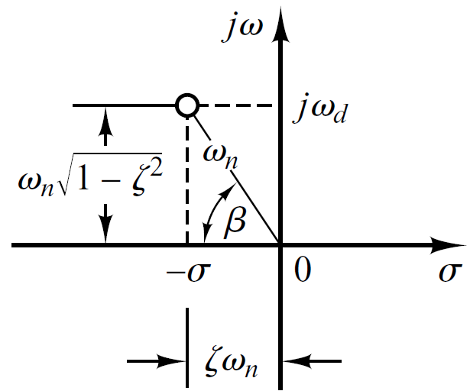
S-Plane

Slide 30
Step Response of underdamped System
Step Response
The partial fraction expansion of above equation is given as

Slide 31
Step Response of underdamped System
Above equation can be written as
Where , is the frequency of transient oscillations and is called damped natural frequency.
The inverse Laplace transform of above equation can be obtained easily if C(s) is written in the following form:

Slide 32
Step Response of underdamped System

Slide 33
Step Response of underdamped System
When

Slide 34
Step Response of underdamped System

Slide 35
Step Response of underdamped System

Slide 36
Step Response of underdamped System

Slide 37
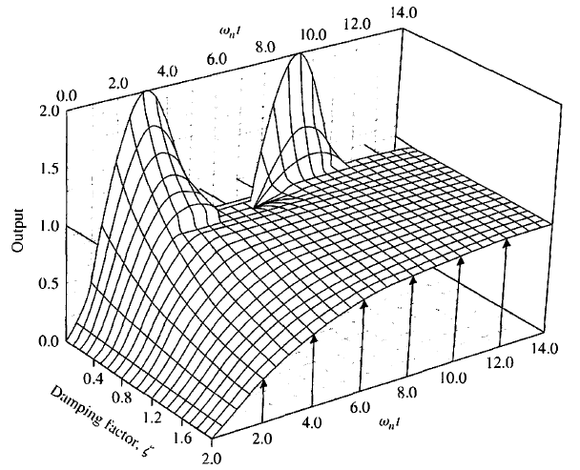
Step Response of underdamped System

Slide 38
Step Response of underdamped System

Slide 39
Step Response of underdamped System

Slide 40
Time Domain Specifications
Rise Time
Peak Time
Settling Time (2%)
Maximum Overshoot
Settling Time (4%)

Slide 41
Example#5
Consider the system shown in following figure, where damping ratio is 0.6 and natural undamped frequency is 5 rad/sec. Obtain the rise time t_{r}, peak time t_{p}, maximum overshoot M_{p}, and settling time 2% and 5% criterion t_{s} when the system is subjected to a unit-step input.

Slide 42
Example#5
Rise Time
Peak Time
Settling Time (2%)
Maximum Overshoot
Settling Time (4%)

Slide 43
Example#5
Rise Time

Slide 44
Example#5
Peak Time
Settling Time (2%)
Settling Time (4%)

Slide 45
Example#5
Maximum Overshoot

Slide 46
Example#5

Slide 47
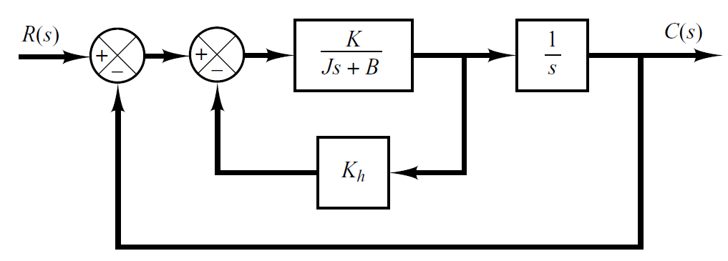
Example#6
For the system shown in Figure-(a), determine the values of gain K and velocity-feedback constant K_{h} so that the maximum overshoot in the unit-step response is 0.2 and the peak time is 1 sec. With these values of K and K_{h}, obtain the rise time and settling time. Assume that J=1 kg-m² and B=1 N-m/rad/sec.

Slide 48
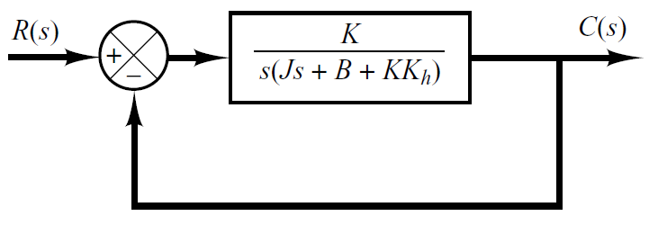
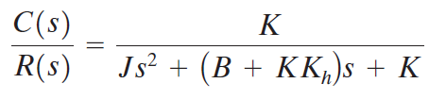
Example#6

Slide 49
Example#6
Comparing above T.F with general 2nd order T.F

Slide 50


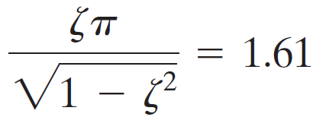

Example#6
Maximum overshoot is 0.2.
The peak time is 1 sec

Slide 51
Example#6

Slide 52
Example#6

Slide 53
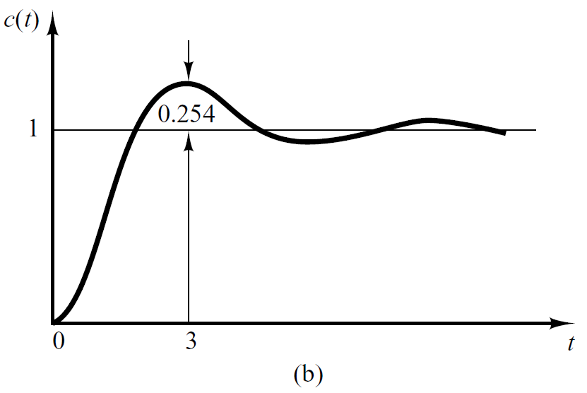
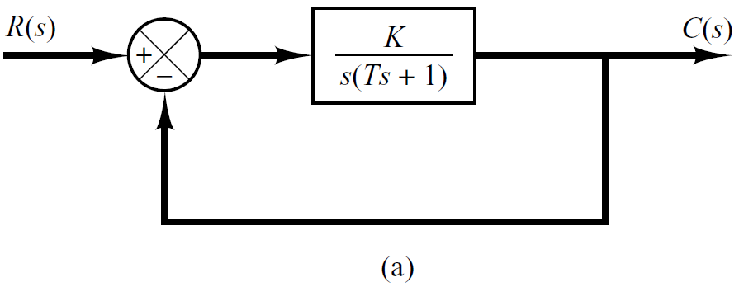
Example#7
When the system shown in Figure(a) is subjected to a unit-step input, the system output responds as shown in Figure(b). Determine the values of a and c from the response curve.

Slide 54
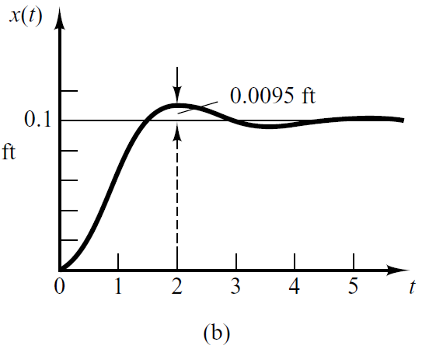
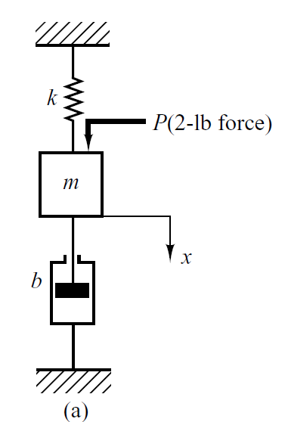
Example#8
Figure (a) shows a mechanical vibratory system. When 2 lb of force (step input) is applied to the system, the mass oscillates, as shown in Figure (b). Determine m, b, and k of the system from this response curve.

Slide 55
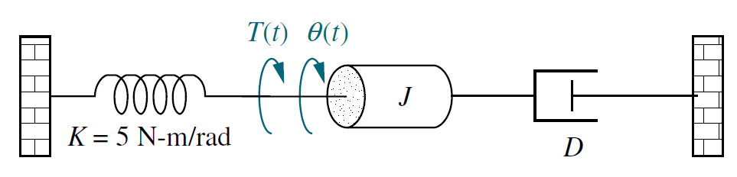
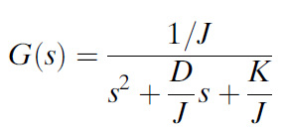




Example#9
Given the system shown in following figure, find J and D to yield 20% overshoot and a settling time of 2 seconds for a step input of torque T(t).

Slide 56


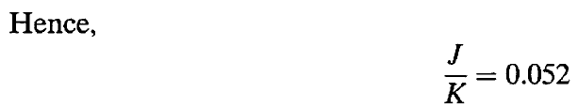

Example#9

Slide 57



Example#9

Slide 58
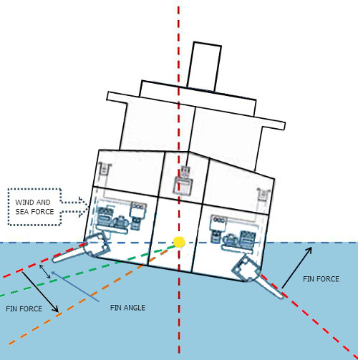
Example # 10
Ships at sea undergo motion about their roll axis, as shown in Figure. Fins called stabilizers are used to reduce this rolling motion. The stabilizers can be positioned by a closed-loop roll control system that consists of components, such as fin actuators and sensors, as well as the ship’s roll dynamics.

Slide 59
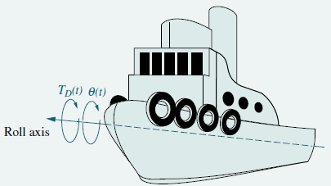
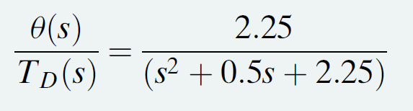
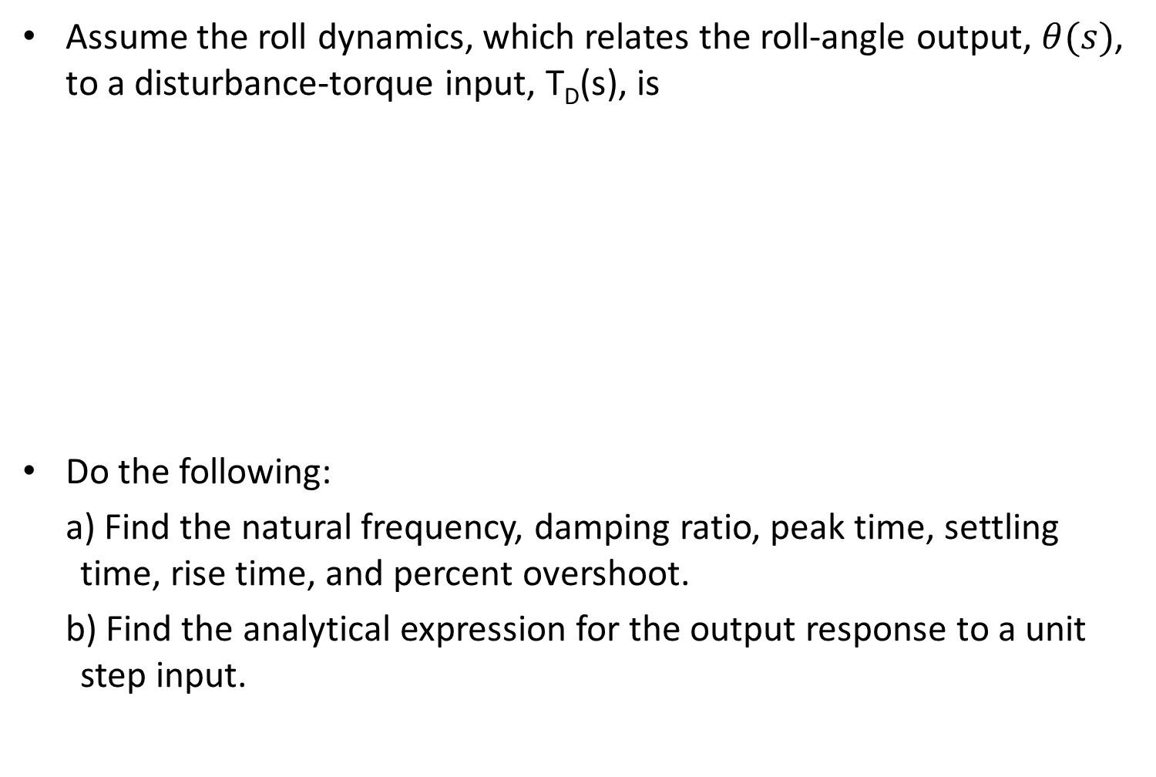
Example # 10
Assume the roll dynamics, which relates the roll-angle output, $θ(s)$, to a disturbance-torque input, T_{D}(s), is
Do the following:
Find the natural frequency, damping ratio, peak time, settling time, rise time, and percent overshoot.
Find the analytical expression for the output response to a unit step input.

Slide 60
Step Response of critically damped System ( )
Step Response
The partial fraction expansion of above equation is given as

Slide 61
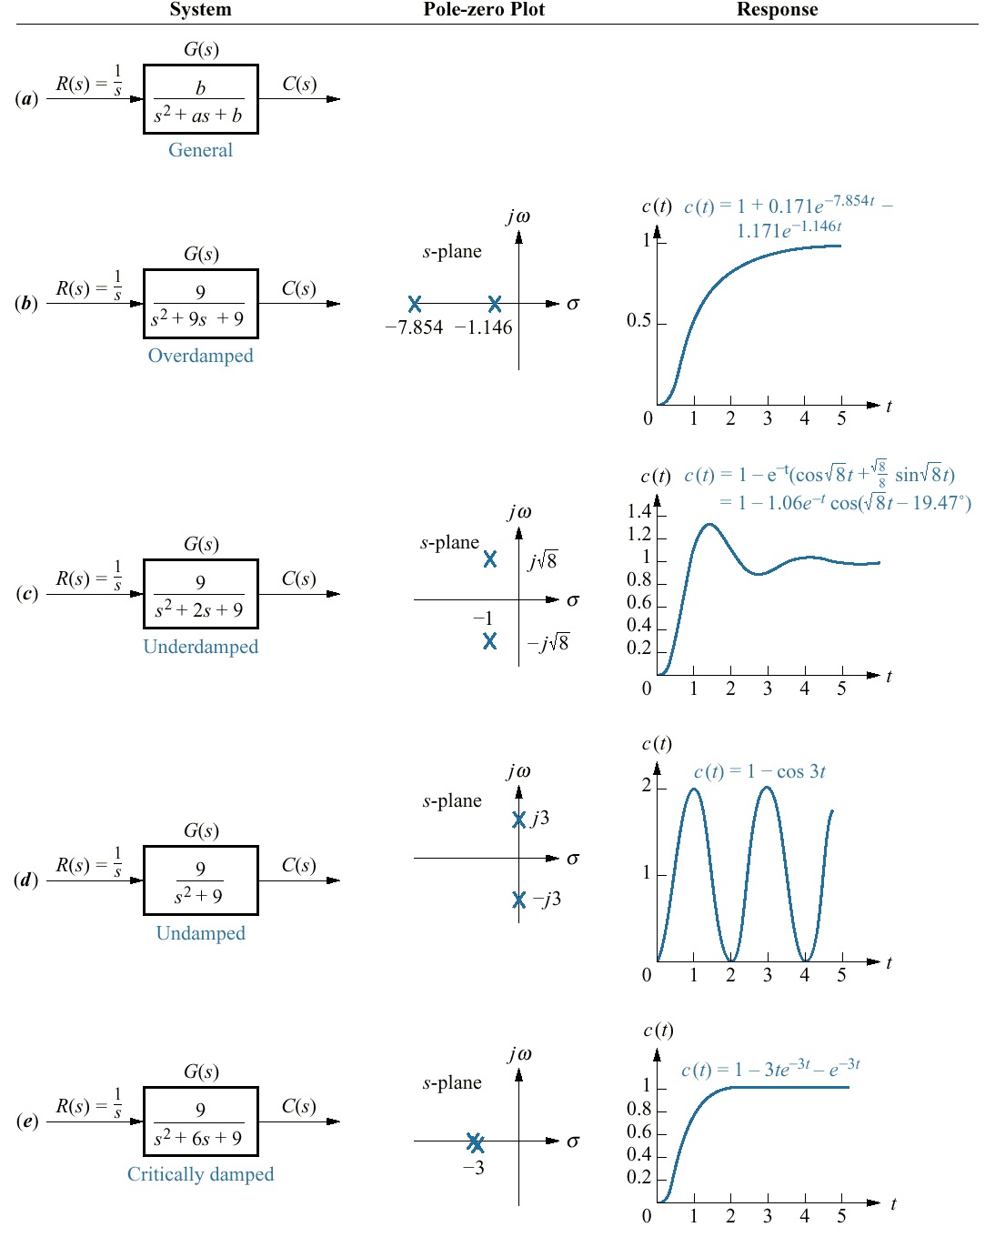

Slide 62
Second – Order System
Example 11: Describe the nature of the second-order system response via the value of the damping ratio for the systems with transfer function
Do them as your own revision

Slide 63
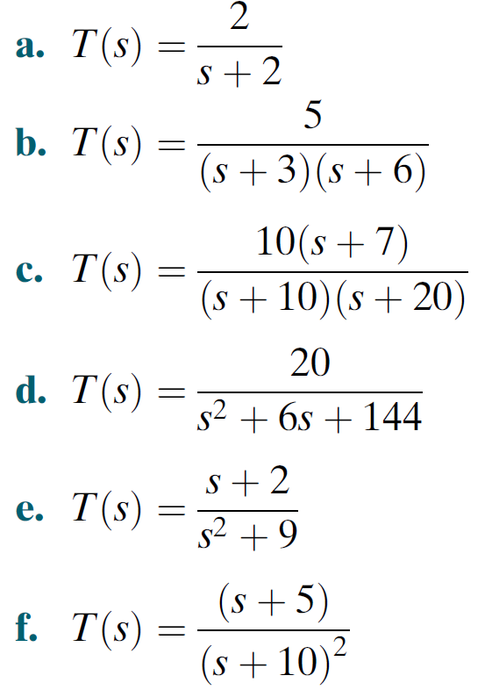
Example-12
For each of the transfer functions find the locations of the poles and zeros, plot them on the s-plane, and then write an expression for the general form of the step response without solving for the inverse Laplace transform. State the nature of each response (overdamped, underdamped, and so on).

Slide 64
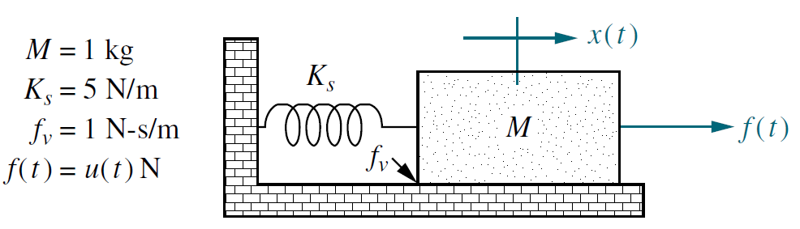
Example-13
Solve for x(t) in the system shown in Figure if f(t) is a unit step.

